Slide 1

CLONING OF THE HNRNPK PROMOTER
Daniel Margarido Galán

Slide 2
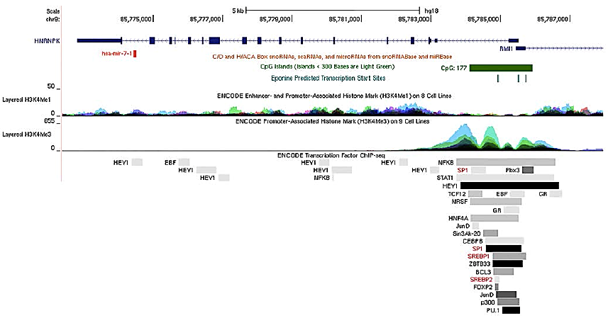
Objective: Cloning the HNRNPK promoter in pGL3 vector, which contains a luciferase gene.
Why? Because research shows that there are predicted binding sites for SP1, SREBP1 and especially SREBP2 in the HNRNPK promoter.
Also, an inadequate posttranscriptional regulation of the gene is linked to insulin resistance, obesity and Alzheimer disease.

Slide 3
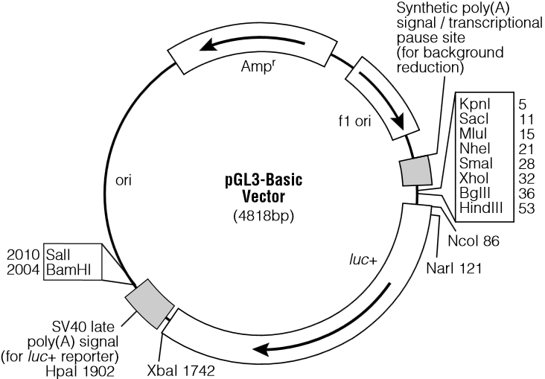
CLONING STRATEGY
Quantitative analysis of factors that potentially regulate mammalian gene expression.
pGL3 vectors contain a modified coding region for firefly (Photinus pyralis) luciferase optimized for monitoring transcriptional activity in transfected eukaryotic cells.
The pGL3-Basic Vector lacks eukaryotic promoter and enhancer sequences, allowing maximum flexibility in cloning putative regulatory sequences. Expression of luciferase activity in cells transfected with this plasmid depends on insertion and proper orientation of a functional promoter upstream from luc+.

Slide 4

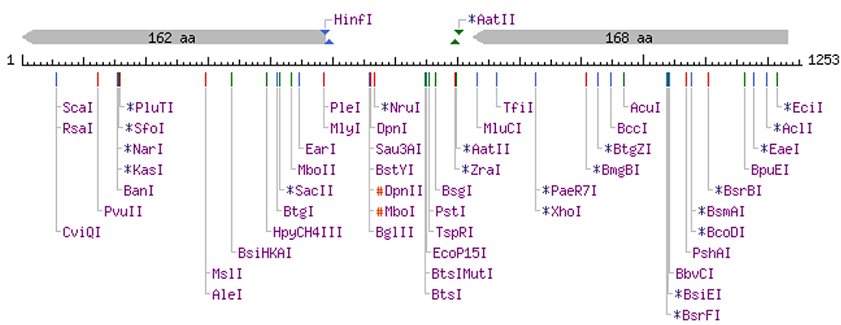
Choosing Restriction Enzymes:
KpnI and HindIII → directional cloning, sticky ends.
No restriction sites for the chosen enzymes within the HNRNPK promoter sequence.
Restriction sites will be added in the primer sequences.

Slide 5
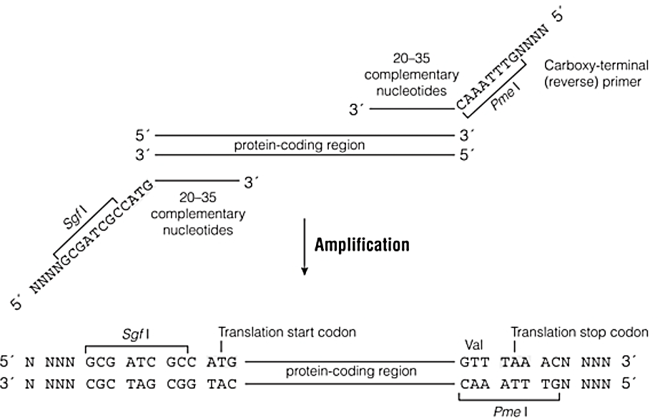
Designing the primers:
Primer sequence: Staple + Restriction site + 16 – 22 complementary nt (promoter sequence).
Promoter sequence: TCAGAACCGAGAGCCCTGTGAA………………GCCATTTCCCTGAGCGTGTATCCGC (1253 pb)
Complementary primer: 5' CCCggtaccTCAGAACCGAGAGCCCTGTG 3’ Reverse complementary primer: 5' CCCaagcttGCGGATACACGCTCAGGGAA 3’
Example:

Slide 6

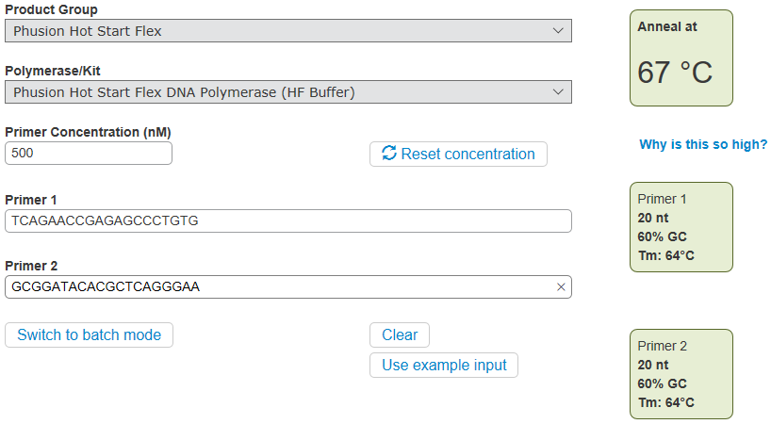
Verifying primer properties:

Slide 7
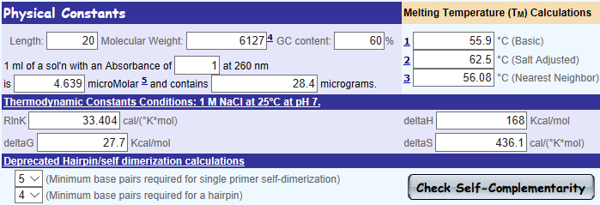
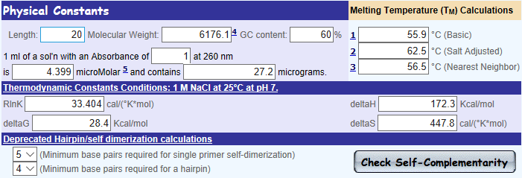

Slide 8
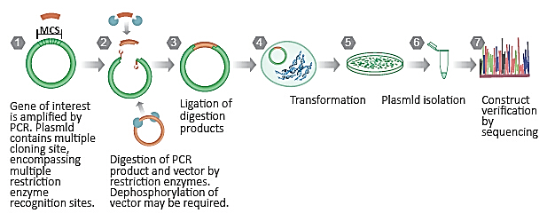
Workflow:
Genomic DNA extraction from cultured cells (SH5 and N2a).
HNRNPK promoter sequence amplification by PCR (using the designed primers).
PCR product purification.
Digestion of the PCR product and the pGL3 vector by restriction enzymes (and dephosphorilation by alkaline phosphatase).
Digestion product purification (gel extraction) and ligation of digestion products (T4 ligase).

Slide 9
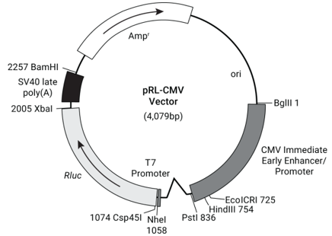
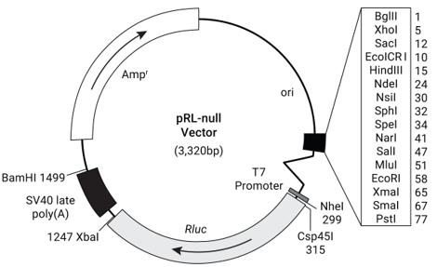
Workflow:
Construct verification by sequencing.
Transformation of the construct in E. coli DH5α.
Plasmid DNA purification by Miniprep (alcaline lisis).
Cotransfection by Lipofectamine of pGL3 vector with Renilla luciferase control vector/null vector (or normalization with total protein concentration by Bradford/Lowry) in HeLa/COS7 cells.
Coexpression of vectors with SREBP1/2 (delipidation with statins for instance). Measure luciferase activity.
Site-directed mutagenesis of predicted binding sites for SREBP1/2. Measure the change in luciferase activity. Confirm transcription factor binding sites.
Confirm that the protein HNRNPK is under the insulin/cholesterol pathway’s control.

Slide 10
Thank you,
Any questions?

